Slide 1
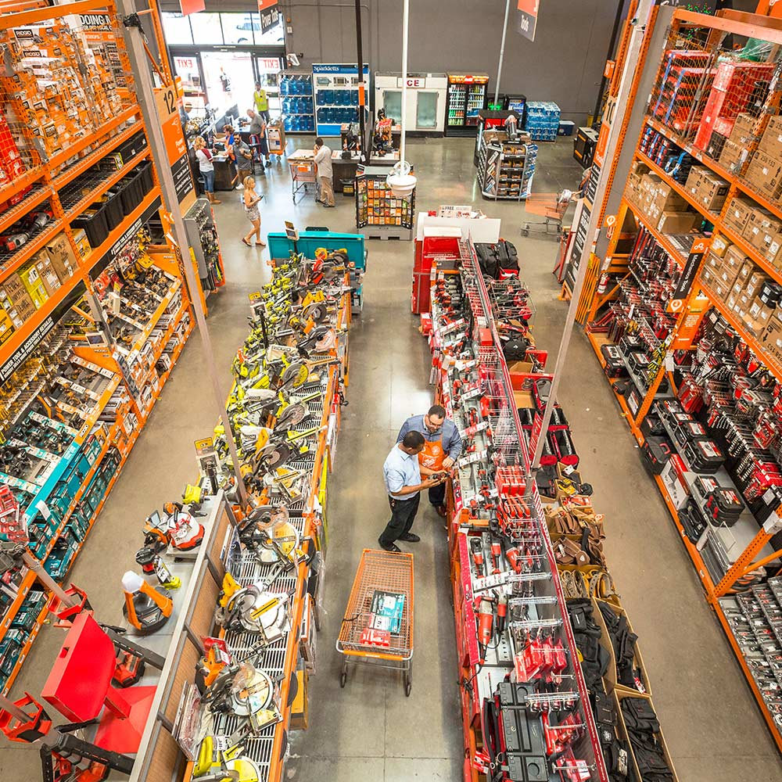

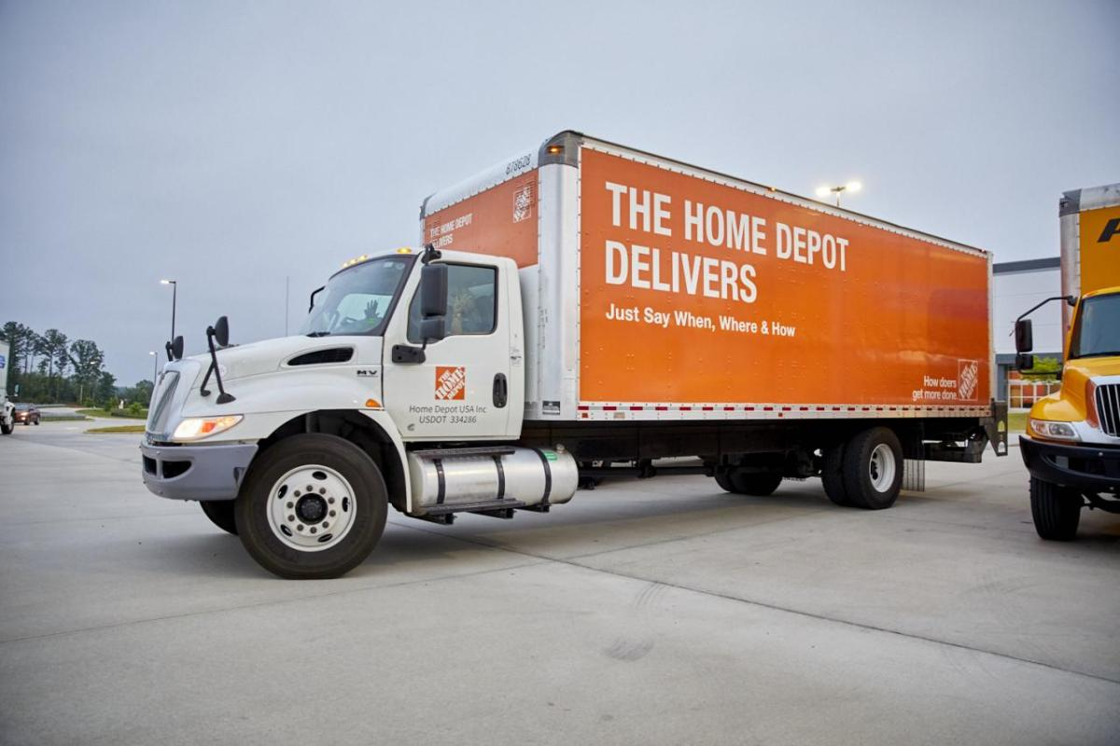
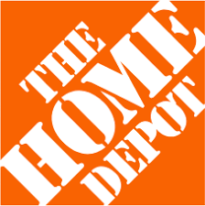
Company Valuation
NYSE: HD
Notes:
I still think it is too much but we can ask the communication professor.

Slide 2





Ethan Fisher
Bates College '29
Economics
Oliver Reynolds
University of Virginia '29
Economics
Riley Uy
New York University '29
Economics
Alex Staniscia
Hamilton College '28
Government
Rose Rahimi
Bard College '26
Computer Science
Meet The Team!

Slide 3
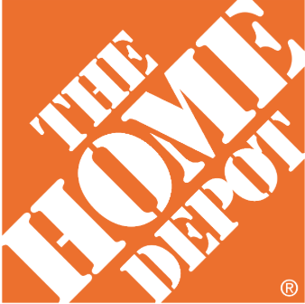
Steady cash generation and scale advantages, offset by near-term housing headwinds, suggest HD should be valued at $235 per share, 30% below its current price
Macro and Housing Uncertainty
Higher mortgage rates and low housing turnover have frozen big-ticket, debt-financed remodels, causing consumers to hold off on large projects
Housing turnover has declined to a 30-year low, with recent coverage still proving the market to be subdued with turnover far below pre-pandemic norms
Pro Ecosystem Anchors Revenue Growth
Pro customers generate larger and more frequent purchases than DIY customers, providing a stable source of recurring revenue
Investments in delivery, fulfillment, and trade-focused services strengthen customer loyalty and help Home Depot capture a greater share of professional spending
Scale and Efficiency Defends Margins
HD's scale, private brands, and omnichannel logistics drive industry-leading profitability: gross margin ~33%, EBIT margin ~12%, and ROIC ~18%
Private label brands and centralized procurement allow HD to hold COGS stable even as rivals face supply-chain pressure, supporting the gross margin assumption
Currently Overvalued
Our DCF values HD at $235 per share – 30% lower than the $334 current market price, implying stronger long-term growth than our model supports
The current share price appears to fully price in future growth opportunities, offering limited upside while leaving investors vulnerable to macroeconomic risks
Notes:
Visual is good
Delivery should happen sooner, say the name of the person and hand over
Enthusiasm during the presentation
Took 3 mins. Tell the story and value drivers. Don’t go into the results
Housing bill that was supposed to be signed yesterday. About the news

Slide 4
Steady cash generation and scale advantages, offset by near-term housing headwinds, suggest HD should be valued at $235 per share, 30% below its current price
Macro and Housing Uncertainty
Higher mortgage rates and low housing turnover have frozen big-ticket, debt-financed remodels, causing consumers to hold off on large projects
Housing turnover has declined to a 30-year low, with recent coverage still proving the market to be subdued with turnover far below pre-pandemic norms
Pro Ecosystem Anchors Revenue Growth
Pro customers generate larger and more frequent purchases than DIY customers, providing a stable source of recurring revenue
Investments in delivery, fulfillment, and trade-focused services strengthen customer loyalty and help Home Depot capture a greater share of professional spending
Scale and Efficiency Defends Margins
HD's scale, private brands, and omnichannel logistics drive industry-leading profitability: gross margin ~33%, EBIT margin ~12%, and ROIC ~18%
Private label brands and centralized procurement allow HD to hold COGS stable even as rivals face supply-chain pressure, supporting the gross margin assumption
Currently Overvalued
Our DCF values HD at $235 per share – 30% lower than the $334 current market price, implying stronger long-term growth than our model supports
The current share price appears to fully price in future growth opportunities, offering limited upside while leaving investors vulnerable to macroeconomic risks

Slide 5
Our customers tell us that they have concerns over uncertainty and housing affordability... fuel costs are rising, mortgage rates have risen again... and layoffs are increasing. As a result, they're continuing to hold off on larger projects.
– Chief Financial Officer, Richard McPhail

Slide 6
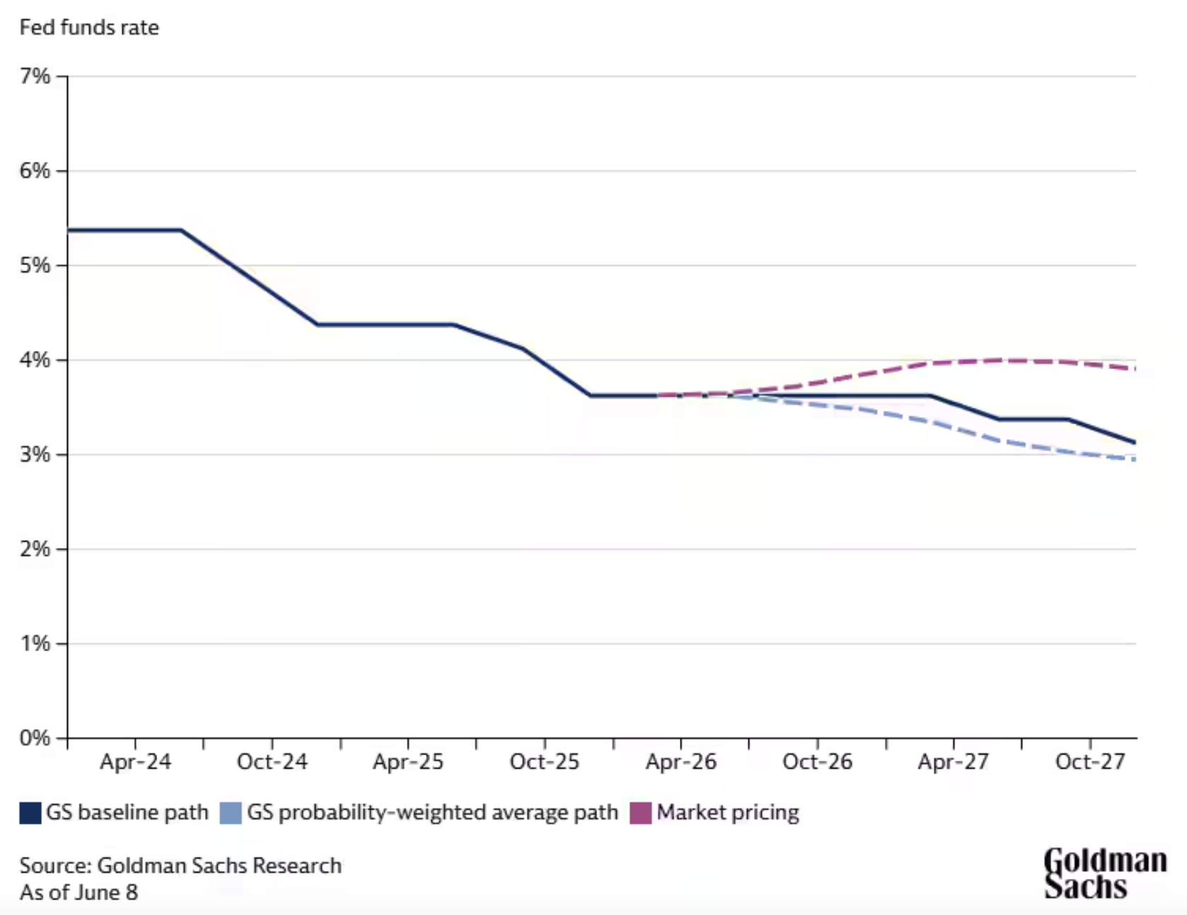
Federal funds rate uncertainty leaves Home Depot in a tough situation given their reliance on big-ticket spending
Macro and Housing Uncertainty • Pro Ecosystem Anchors Revenue Growth • Scale and Efficiency Defends Margins • Currently Overvalued
Notes:
HD doesn't need rates to be low — it needs people to believe rates are coming down so they commit to moving and renovating
When the path is this uncertain, buyers and sellers sit on the sidelines and wait

Slide 7
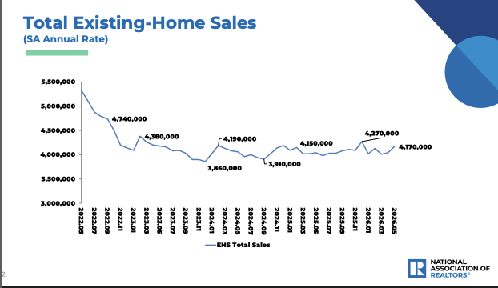
Existing home sales remain near 30-year lows, suppressing the primary trigger for big-ticket home improvement spending
Source: National Association of Realtors
Macro and Housing Uncertainty • Pro Ecosystem Anchors Revenue Growth • Scale and Efficiency Defends Margins • Currently Overvalued
Notes:
Chart shows total existing home sales, early 2022 through mid-2026
Seasonally adjusted annual rate — smooths out monthly noise
Sales peaked ~5.5M units in early 2022
Collapsed to ~3.86M by late 2023 — roughly 30% decline in under two years
Driven by the Fed's aggressive rate hiking cycle
Most homeowners locked in mortgages at 2.5–3.5% in 2020–2021
Selling means giving that rate up and taking a new one at 6.5–7%
So they stay put — inventory stays tight, transactions stay depressed
Home sales are the #1 trigger for big-ticket improvement spending
When you buy a house — kitchen, floors, bathrooms all follow
HD has flagged transactions over $1,000 as their most pressured category
Fewer sales = fewer of those projects getting started
Sales have ticked back up to ~4.17M as of May 2026
Positive sign, but still well below the 5–5.5M historical norm
Housing turnover drives HD's highest-value transactions

Slide 8
Declining transactions and resilient average ticket reveal consumers are deferring large projects, not leaving the category
Source: SEC.gov Home Depot 8-K Filings
Macro and Housing Uncertainty • Pro Ecosystem Anchors Revenue Growth • Scale and Efficiency Defends Margins • Currently Overvalued
Notes:
Consumer spending behavior shift
Bar chart comparing HD average ticket growth vs transaction count growth
Shows ticket up and transactions flat/negative
There is a growing uptick in
Q2'21 → Q4'22 (the boom):
Orange bars are huge — 10-13% average ticket growth. Customers were spending a lot per trip, driven by the pandemic home improvement surge and inflation pushing prices up. Comps were strong.
Q4'22 → Q1'23 (the turn):
The gray bars go negative for the first time — fewer people coming in. The orange ticket bars shrink dramatically too. Comps (blue line) collapse to around -5%.
Q1'23 → Q1'26 (where we are now):
This is the key period. Gray bars are slightly negative to flat — transaction counts are still weak, meaning fewer customer visits. But orange bars are hovering just above zero — people who do come in are spending roughly the same amount per trip. So comps are flat to slightly positive, not because traffic recovered, but because ticket is holding.

Slide 9
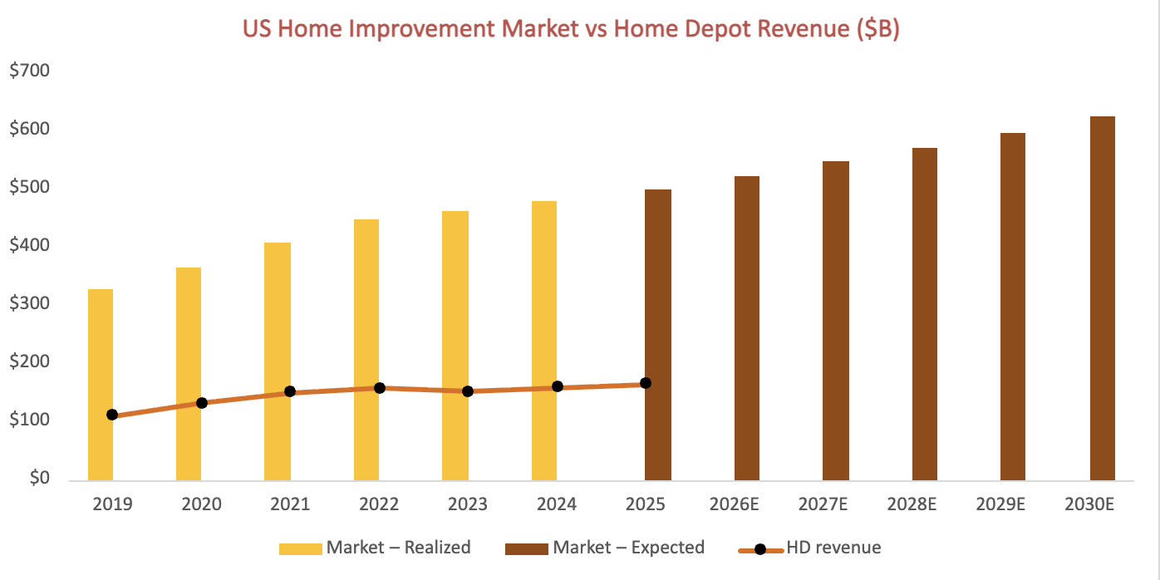
The U.S. home improvement market remains large and structurally intact, indicating a cyclical slowdown, not structural decline
Source: sec.gov, 10-k fillings (2019-2025) and Statista; TechSci Research
Macro and Housing Uncertainty • Pro Ecosystem Anchors Revenue Growth • Scale and Efficiency Defends Margins • Currently Overvalued
Notes:
Use transition to next chapter that talks about the growing forecast of the overall industry and that HD is using M&A that will be talked about in next chapter
Talk about positioning of the consistent pro consumer base coming back all the time
Talk about the inelastic demand, where you need to fix stuff if it is broken
Talk about how the market is growing and
The market is relatively stagnant so they have been looking toward M&A in order to grow
That’s what propels us into the next section as they are looking for ways to grow

Slide 10
Steady cash generation and scale advantages, offset by near-term housing headwinds, suggest HD should be valued at $235 per share, 30% below its current price
Macro and Housing Uncertainty
Higher mortgage rates and low housing turnover have frozen big-ticket, debt-financed remodels, causing consumers to hold off on large projects
Housing turnover has declined to a 30-year low, with recent coverage still proving the market to be subdued with turnover far below pre-pandemic norms
Pro Ecosystem Anchors Revenue Growth
Pro customers generate larger and more frequent purchases than DIY customers, providing a stable source of recurring revenue
Investments in delivery, fulfillment, and trade-focused services strengthen customer loyalty and help Home Depot capture a greater share of professional spending
Scale and Efficiency Defends Margins
HD's scale, private brands, and omnichannel logistics drive industry-leading profitability: gross margin ~33%, EBIT margin ~12%, and ROIC ~18%
Private label brands and centralized procurement allow HD to hold COGS stable even as rivals face supply-chain pressure, supporting the gross margin assumption
Currently Overvalued
Our DCF values HD at $235 per share – 30% lower than the $334 current market price, implying stronger long-term growth than our model supports
The current share price appears to fully price in future growth opportunities, offering limited upside while leaving investors vulnerable to macroeconomic risks
Notes:
If interest rates rise the housing cost will rise too
Making housing uncertainty first bullet
Considering the competitors in housing system
What percent of revenue is DIY, Pro, and Distribution, if you were to go back 5 years what is the compound growth rate. Which category is growing fast?
Other things that make it a sticky for pro customers
BLDR, what is it going and where is it going?
Show if the margins have held or improved? A few year of their 10-k
From profit and loss to terminal value
Add page numbers to slides
Talk
irst, our Pro base is a major structural advantage. Because contractors rely on us for their daily operations, they buy more and visit more often than DIYers. This provides a highly predictable stream of recurring revenue that protects us during market slowdowns."
Second, we are actively locking in this loyalty. By investing in job-site delivery and specialized fulfillment, we solve their biggest logistics headaches. This allows Home Depot to capture a greater share of professional spending and pull market share away from smaller competitors."

Slide 11

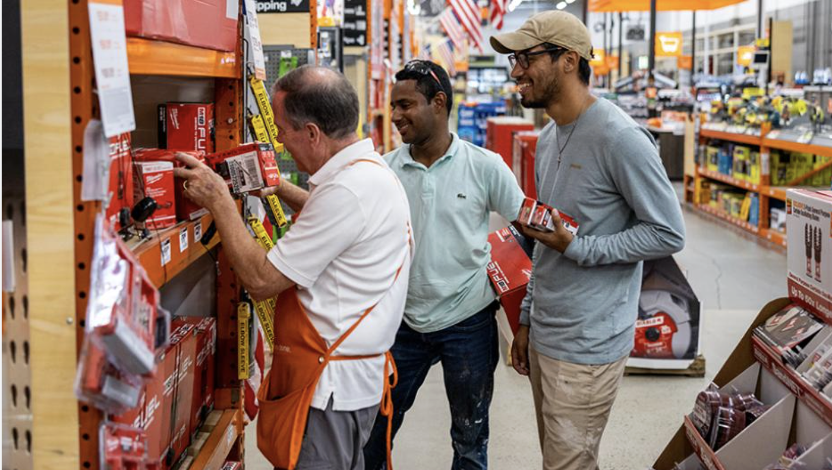
Pro customers spend more, visit more often, and churn less, making them a structurally superior revenue source compared to DIY
~50% of sales come from professional customers, despite making up roughly ~10% of total customers
DIY customers typically spend 1/5 as much per transaction as Pros and visit stores less frequently, making them a less predictable revenue source
Pro vs. DIY
Macro and Housing Uncertainty • Pro Ecosystem Anchors Revenue Growth • Scale and Efficiency Defends Margins • Currently Overvalued
Notes:
Pro customers spend more vistnmore often and churn less making them a structually superior revenue source compared to diy
"As you can see on the left, Professional customers account for roughly 50% of our total sales,

Slide 12


SRS and GMS open two new addressable markets worth hundreds of billions
Expands Home Depot into the highly fragmented roofing distribution market, serving professional contractors nationwide
Adds exposure to large, recurring repair and replacement demand across roofing, landscaping, and building products
Adds leading positions in drywall, ceilings, steel framing, and specialty building materials serving residential and commercial construction
Creates cross-selling opportunities with SRS while expanding Home Depot's reach across the entire professional construction project lifecycle
Macro and Housing Uncertainty • Pro Ecosystem Anchors Revenue Growth • Scale and Efficiency Defends Margins • Currently Overvalued
Notes:
SRS – independent subsidiary
Grows HD's addressable market by about $50B
GMS – captures dominant share in $200B market
These recent acquisitions show Home Depot's strategic shift toward serving professional customers across a broader range of construction and maintenance categories, which further separates it from its competitors
Probably too many words here; paraphrase/cut down on this and utilize speaking to convey points

Slide 13
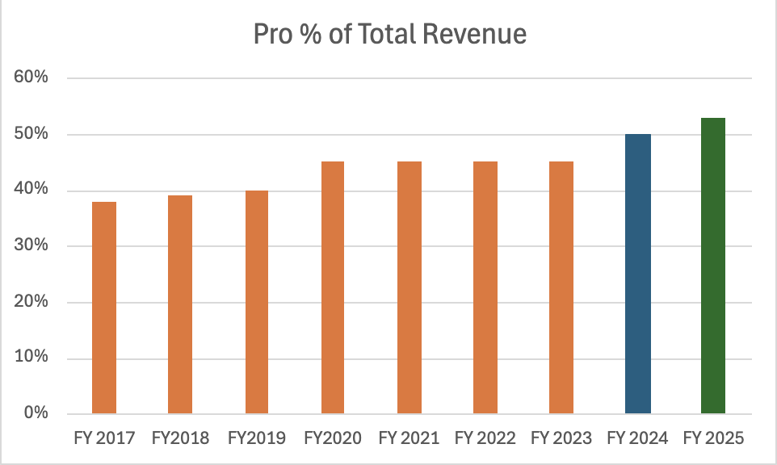
Pro's share of total revenue has risen steadily, with SRS and GMS acquisitions accelerating the shift
SRS acquisition year
GMS acquisition year
Source: Home Depot 10-K Filings
Macro and Housing Uncertainty • Pro Ecosystem Anchors Revenue Growth • Scale and Efficiency Defends Margins • Currently Overvalued

Slide 14
New M&A driving recent revenue growth
Source: Home Depot 10-K Filings
Macro and Housing Uncertainty • Pro Ecosystem Anchors Revenue Growth • Scale and Efficiency Defends Margins • Currently Overvalued
Notes:
Specify that orange line is the sum of the others "total revenue"
Highlight that the other section specifies the new M&A
Revenue growth forecast
Bar chart showing actual rev over last 3 years
Followed by 5 year forecast
Color actuals diff from projections
* add detailed revenue

Slide 15
Steady cash generation and scale advantages, offset by near-term housing headwinds, suggest HD should be valued at $235 per share, 30% below its current price
Macro and Housing Uncertainty
Higher mortgage rates and low housing turnover have frozen big-ticket, debt-financed remodels, causing consumers to hold off on large projects
Housing turnover has declined to a 30-year low, with recent coverage still proving the market to be subdued with turnover far below pre-pandemic norms
Pro Ecosystem Anchors Revenue Growth
Pro customers generate larger and more frequent purchases than DIY customers, providing a stable source of recurring revenue
Investments in delivery, fulfillment, and trade-focused services strengthen customer loyalty and help Home Depot capture a greater share of professional spending
Scale and Efficiency Defends Margins
HD's scale, private brands, and omnichannel logistics drive industry-leading profitability: gross margin ~33%, EBIT margin ~12%, and ROIC ~18%
Private label brands and centralized procurement allow HD to hold COGS stable even as rivals face supply-chain pressure, supporting the gross margin assumption
Currently Overvalued
Our DCF values HD at $235 per share – 30% lower than the $334 current market price, implying stronger long-term growth than our model supports
The current share price appears to fully price in future growth opportunities, offering limited upside while leaving investors vulnerable to macroeconomic risks
Notes:
If interest rates rise the housing cost will rise too
Making housing uncertainty first bullet
Considering the competitors in housing system
What percent of revenue is DIY, Pro, and Distribution, if you were to go back 5 years what is the compound growth rate. Which category is growing fast?
Other things that make it a sticky for pro customers
BLDR, what is it going and where is it going?
Show if the margins have held or improved? A few year of their 10-k
From profit and loss to terminal value
Add page numbers to slides
Talk about the range in the 4th chapter if the rage is larger, range in the headline if the range is narrow

Slide 16


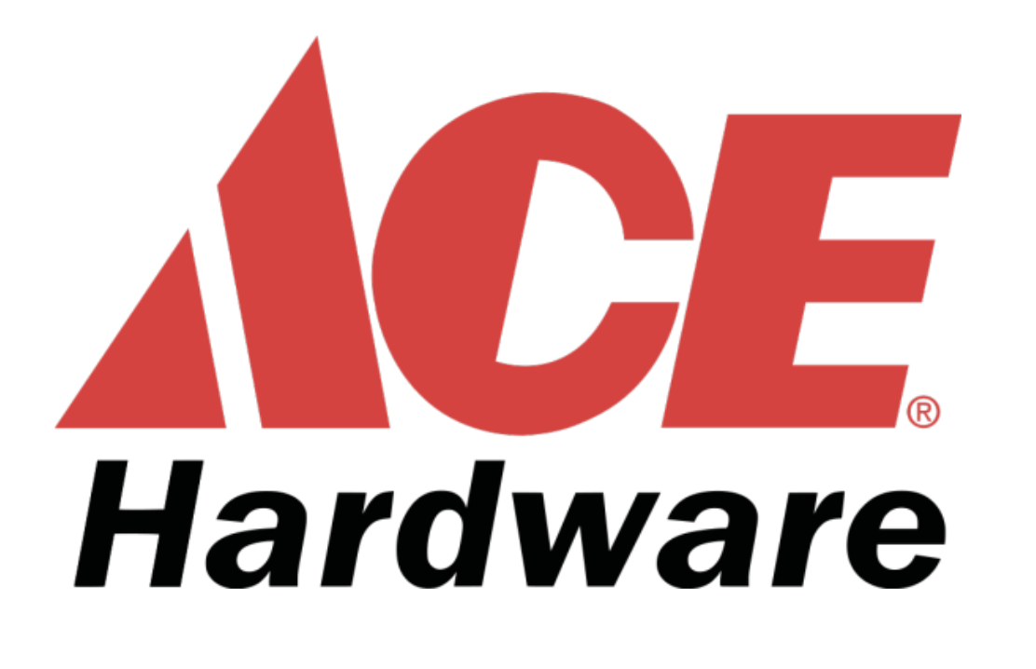




Home Depot Occupies the Industry's Most Attractive Competitive Position
High Service
Limited Selection
Broad Selection
Low Service
Macro and Housing Uncertainty • Pro Ecosystem Anchors Revenue Growth • Scale and Efficiency Defend Margins • Currently Overvalued
Notes:
Explain what map shows

Slide 17
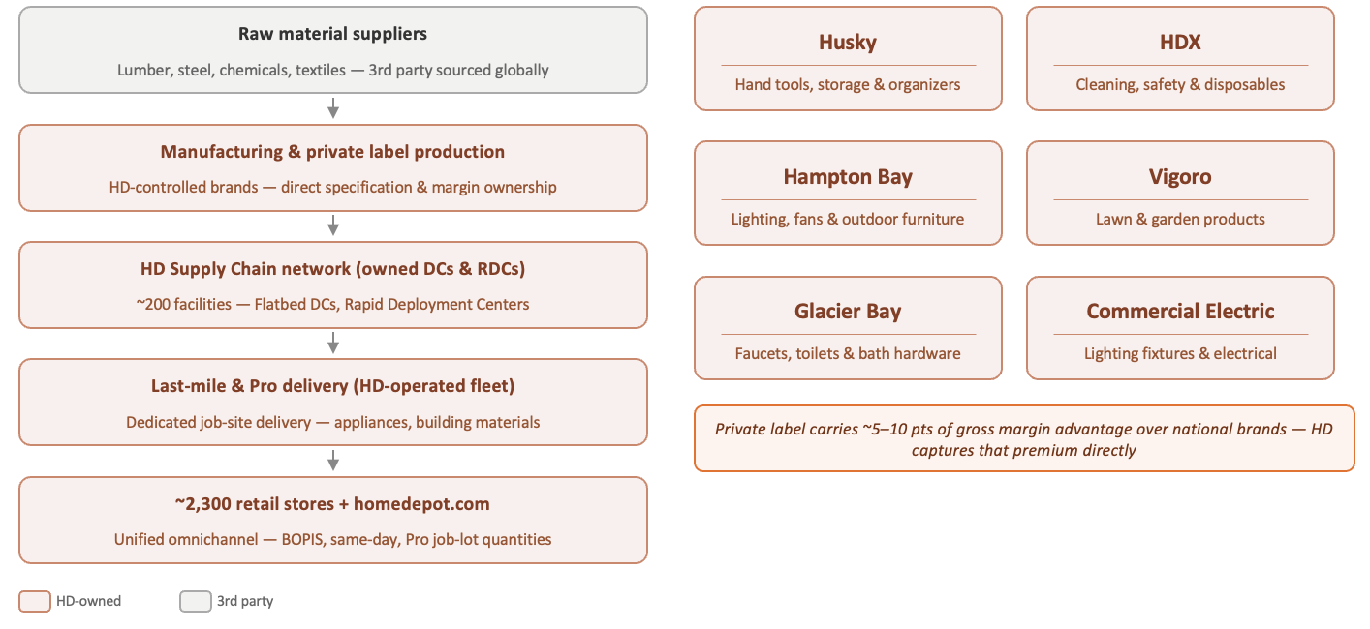
Vertical integration across sourcing, distribution, and private label gives HD direct control over its cost structure
Vertical Value Chain
Private Label Portfolio
Source: The Home Depot, Inc. Form 10-K, Fiscal Year 2024 (SEC Filing, Feb. 2025), The Home Depot, Inc. Private Brands
Macro and Housing Uncertainty • Pro Ecosystem Anchors Revenue Growth • Scale and Efficiency Defend Margins • Currently Overvalued
Notes:
- Highlight that the portfolio of private label brands makes up 25% of total revenue
Private label helps sustain their margins because it bypasses potential costs of marketing and R&D
Emphasize how vertical integration protects them from unstable economy including tariffs because majority of their products are sourced from the US
Slide intro (set the thesis):
"One of Home Depot's most underappreciated competitive advantages is how much of its supply chain it actually owns. From distribution infrastructure to the brands on the shelf, HD has built a vertically integrated model that gives it direct control over its cost structure — something most competitors simply can't replicate."
Walking the flow diagram (top to bottom):
Raw materials — "Like any retailer, HD starts with third-party suppliers for raw inputs. But that's where the third-party dependency largely ends."
Manufacturing / Private Label — "HD specifies and owns the brands at the manufacturing level. When you buy a Husky wrench or an HDX cleaning supply, HD controls the product spec, the cost, and the margin — not a national brand."
Distribution network — "HD operates roughly 200 distribution facilities, including its Rapid Deployment Centers and Flatbed DCs. This is a massive capital investment, but it means HD can bypass third-party logistics for a large portion of its volume."
Last-mile delivery — "Especially important for the Pro customer — HD runs a dedicated job-site delivery program for heavy materials like lumber, drywall, and appliances. That's not outsourced; that's HD trucks."
Stores and digital — "And finally, HD controls the retail channel directly — 2,300+ stores plus homedepot.com. No wholesale middleman, no distributor taking a cut."
Private label grid (bottom section):
"The private label portfolio is where you really see the margin story. These six brands — Husky, HDX, Hampton Bay, Vigoro, Glacier Bay, and Commercial Electric — span almost every category in the store. HD doesn't pay a brand premium; it captures that premium. Private label typically carries 5-10 points of gross margin advantage over equivalent national brands."
Closing the slide:
"Taken together, this vertical integration gives HD a structural cost advantage. When lumber prices spike or freight rates rise, HD has more levers to pull than a traditional retailer does. That's why gross margins have held up even through the housing downturn — the cost structure is partially insulated by what HD controls internally."

Slide 18
Gross margin has held near 33% through supply chain shocks and inflation, proving the structural durability of HD's cost position
Source: Home Depot 10-K filings, FY2025E per company guidance
Macro and Housing Uncertainty • Pro Ecosystem Anchors Revenue Growth • Scale and Efficiency Defend Margins • Currently Overvalued

Slide 19
Steady cash generation and scale advantages, offset by near-term housing headwinds, suggest HD should be valued at $235 per share, 30% below its current price
Macro and Housing Uncertainty
Higher mortgage rates and low housing turnover have frozen big-ticket, debt-financed remodels, causing consumers to hold off on large projects
Housing turnover has declined to a 30-year low, with recent coverage still proving the market to be subdued with turnover far below pre-pandemic norms
Pro Ecosystem Anchors Revenue Growth
Pro customers generate larger and more frequent purchases than DIY customers, providing a stable source of recurring revenue
Investments in delivery, fulfillment, and trade-focused services strengthen customer loyalty and help Home Depot capture a greater share of professional spending
Scale and Efficiency Defends Margins
HD's scale, private brands, and omnichannel logistics drive industry-leading profitability: gross margin ~33%, EBIT margin ~12%, and ROIC ~18%
Private label brands and centralized procurement allow HD to hold COGS stable even as rivals face supply-chain pressure, supporting the gross margin assumption
Currently Overvalued
Our DCF values HD at $235 per share – 30% lower than the $334 current market price, implying stronger long-term growth than our model supports
The current share price appears to fully price in future growth opportunities, offering limited upside while leaving investors vulnerable to macroeconomic risks

Slide 20
Conservative assumptions anchor a credible DCF
Base case assumptions | USD millions | Forecast period 2026E–2030E
Driver | Base Case | Rationale
Revenue growth | 3.5% | Flat 3.5%/yr; below the 4.5% optimistic case
Gross margin | 33.1% | Held at ~33% historical; no expansion
Cap Ex % of sales | 2.5% | Above-trend reinvestment (hist. ~2.1%)
WACC | 9.2% | CAPM: rf 4.5%, β 0.97, MRP 6%
Terminal growth rate | 3.0% | Nominal GDP long run growth; well below WACC
Exit Multiple | 13.3x | Peer median EV/EBITDA: LOW 13.0x, FND 13.1x, TSCO 13.7x; avg 13.3x applied to FY2030E EBITDA
Macro and Housing Uncertainty • Pro Ecosystem Anchors Revenue Growth • Scale and Efficiency Defend Margins • Currently Overvalued
Notes:
We used six key inputs. Revenue growth of 3.5% per year, which is below HD's own five-year CAGR and well below the optimistic case of 4.5%.
Gross margin held flat at 33.1%, consistent with history.
EBIT margin at 12%, assuming no operating leverage benefit going forward.
CapEx at 2.5% of sales, which is above HD's historical 2.1% to reflect the continued supply chain buildout.
WACC of 9.2%, built from a risk-free rate of 4.5%, beta of 0.97, and a 6% market risk premium using CAPM.
And a terminal growth rate of 3%, which equals long-run US nominal GDP. We are not assuming HD shrinks. We are not being catastrophically bearish. We are assuming HD performs at the pace of the overall economy in perpetuity.
Takeaway: conservative, not heroic — modest growth, flat margins, elevated CapEx, sub-GDP terminal rate.
Will we be able to explain/talk about these numbers and how they go into our DCF/Statement model should we get any questions about it?

Slide 21
Free cash flow grows steadily from ~$11.9B to ~$17.4B across the forecast period, reflecting a mature and stable business
Source: Home Depot 10-K, Group Analysis
Macro and Housing Uncertainty • Pro Ecosystem Anchors Revenue Growth • Scale and Efficiency Defend Margins • Currently Overvalued
Notes:
With those assumptions, our model produces free cash flow growing steadily from roughly $15 billion in year one to $17 billion by 2030. The shape matters more than any individual year. This is a mature, cash-generative business with predictable output. No J-curve, no moonshot growth. Just consistent, compounding cash flow from a scaled operation. That is exactly the business we want to value, and it is what our terminal value calculation is anchored to.
The net effect in FY2025 was a $3,748M increase in NWC. That means HD had to fund $3,748M more in working capital than the year before, almost entirely because SRS brought in a large inventory and receivables base that did not exist in HD's books before the acquisition.

Slide 22
Two methods converge on a clear verdict: HD is worth $182–$235, well below $334
PERPETUITY
$185.1B
TV (Perp)
$244.9B
Enterprise Value
($65.4B)
Less
Debt
$1.4B
Plus Cash
$181.0B
Equity
Value
997.1M
Shares
$182
Price Per
Share
$59.9B
Sum of PV
of FCFs
$238.2B
TV (Exit)
$298.1B
Enterprise Value
($65.4B)
Less Debt
$1.4B
Plus
Cash
$234.1B
Equity
Value
997.1M
Shares
$235
Price Per
Share
EXIT MULTIPLE
PERPETUITY → $182 per share
vs. $334 market price | 84% premium
EXIT MULTIPLE → $235 per share
vs. $334 market price | 42% premium
Macro and Housing Uncertainty • Pro Ecosystem Anchors Revenue Growth • Scale and Efficiency Defend Margins • Currently Overvalued
Notes:
Two independent methods. Two different terminal value assumptions. Both land at roughly the same conclusion. HD is worth $182 to $235. The market is pricing it at $334.
That is 30% overvalued on the generous method. 45% overvalued on the fundamental method. We want to be clear: we are not saying HD is a bad business. We are saying the market is paying for growth that the fundamentals do not support.
Perpetuity
beyond 2030, HD generates cash that grows at 3% per year forever, and you discount that infinite stream back to today. The formula is FCF × (1 + g) ÷ (WACC − g), which equals $17,453M × 1.03 ÷ (9.24% − 3.0%) = $287,951M terminal value in 2030. Discount that back five years at 9.24% and you get $185.1B today. Add the $59.9B of discounted FCFs, subtract net debt, divide by shares, and you land at $181.54, which rounds to $182. The 3% growth rate is your explicit assumption. You chose it because it equals long run US nominal GDP growth, meaning you are saying HD grows no faster than the overall economy forever after year 5. That is a deliberately conservative, defensible assumption.
Exit Multiple
I do not know what happens after 2030 in perpetuity, so instead of modeling it I will just assume someone buys the whole business in 2030 at a market multiple. You picked 13.25x EV/EBITDA, applied it to your forecast 2030 EBITDA of $28.0B, and got a terminal value of $370.6B. Discount that back, add FCFs, subtract net debt, divide by shares, and you get $234.82, which rounds to $235. The 13.25x multiple is not your explicit assumption about growth. It is borrowed from what comparable businesses trade at today, discounted by about 13% from HD's current 15.2x to reflect your bearish housing view.
"even under a generous market multiple assumption, exit value reaches only $235."

Slide 23
Only the most optimistic WACC and terminal growth assumptions justify today's $334 market price, with most scenarios pointing lower
 |  | Terminal Growth Rate
 |  | 1.50% | 2.00% | 2.50% | 3.00% | 3.50% | 4.00% | 4.50%
WACC | 7.75% | $194 | $212 | $234 | $300 | $292 | $333 | $386
 | 8.25% | $174 | $190 | $208 | $229 | $254 | $286 | $326
 | 8.75% | $157 | $171 | $186 | $203 | $224 | $249 | $280
 | 9.25% | $143 | $154 | $166 | $182 | $198 | $219 | $243
 | 9.75% | $130 | $139 | $150 | $162 | $177 | $194 | $214
 | 10.25% | $118 | $127 | $136 | $147 | $159 | $173 | $190
 | 10.75% | $108 | $116 | $124 | $133 | $143 | $155 | $169
Macro and Housing Uncertainty • Pro Ecosystem Anchors Revenue Growth • Scale and Efficiency Defend Margins • Currently Overvalued
Notes:
A natural question is: what if our assumptions are wrong? So, we stress-tested the model across 49 combinations of WACC and terminal growth rate.
The color tells the story. Most of the grid is red or darker red, meaning most scenarios produce a price well below $334. The red zone, where the model actually justifies the current price, is in the top right corner. The one cell out of 49.
To justify $334, you need to simultaneously assume a WACC below 8% and terminal growth above 4%. A WACC below 8% means you believe HD is safer than nearly any equity in the market. A terminal growth rate above 4% means HD grows faster than the US economy indefinitely. Both at the same time.
We think that is an unrealistic combination given the housing cycle, the interest rate environment, and the competitive pressure from Lowe's and specialty players. Our overvaluation conclusion is not dependent on any single assumption. It holds across almost the entire grid.

Slide 24
Steady cash generation and scale advantages, offset by near-term housing headwinds, suggest HD should be valued at $235 per share, 30% below its current price
Macro and Housing Uncertainty
Higher mortgage rates and low housing turnover have frozen big-ticket, debt-financed remodels, causing consumers to hold off on large projects
Housing turnover has declined to a 30-year low, with recent coverage still proving the market to be subdued with turnover far below pre-pandemic norms
Pro Ecosystem Anchors Revenue Growth
Pro customers generate larger and more frequent purchases than DIY customers, providing a stable source of recurring revenue
Investments in delivery, fulfillment, and trade-focused services strengthen customer loyalty and help Home Depot capture a greater share of professional spending
Scale and Efficiency Defends Margins
HD's scale, private brands, and omnichannel logistics drive industry-leading profitability: gross margin ~33%, EBIT margin ~12%, and ROIC ~18%
Private label brands and centralized procurement allow HD to hold COGS stable even as rivals face supply-chain pressure, supporting the gross margin assumption
Currently Overvalued
Our DCF values HD at $235 per share – 30% lower than the $334 current market price, implying stronger long-term growth than our model supports
The current share price appears to fully price in future growth opportunities, offering limited upside while leaving investors vulnerable to macroeconomic risks
Notes:
Don't need to spend nearly as much time; focus on final valuation and big picture – main idea + takeaway to reinforce what has been said

Slide 25
Appendix
3. Executive Summary
6. Federal Funds Rate
14. Revenue Breakdown
20. DCF Assumptions
21. Free Cash Flow

